Slide 1
Vintage Torn Paper Aesthetic Agency Infographics
Here is where this template begins

Slide 2
Vintage torn paper aesthetic agency
This template contains an assortment of complementary infographic resources for the Vintage Torn Paper Aesthetic Agency presentation.
These infographics are adapted to the style of the aforementioned presentation, so you can insert them easily and have them completely integrated at once. You just need to do the following:
  Select the element that you want to copy
  Right-click and choose “Copy”
  Go to the slide where you want the element to appear
  Right-click and choose “Paste”

Slide 3
Vintage torn paper aesthetic agency
01
02
Venus
Jupiter
Introduction
This can be the part of the presentation where you can introduce your company or agency. Keep it short and go straight to the point. Your audience will appreciate it
Venus is the second planet from the Sun
Jupiter is the biggest planet of them all
03
04
Mars
Saturn
Mars is full of iron oxide dust
Saturn was named after a Roman god

Slide 4
Vintage torn paper aesthetic agency
Venus
It’s the second planet from the Sun
Mercury
Mercury is the closest planet to the Sun
Saturn
It’s composed of hydrogen and helium
Aesthetic agency

Slide 5
Vintage torn paper aesthetic agency
Venus
Jupiter
It’s the second planet from the Sun
Jupiter is the biggest planet of them all
Mercury
Mars
Mercury is the closest planet to the Sun
Mars is actually a very cold place
Saturn
Neptune
It’s composed of hydrogen and helium
Neptune is the farthest planet from the Sun
Our values

Slide 6
Vintage torn paper aesthetic agency
2019
2020
Venus is the second planet from the Sun
Jupiter is the biggest planet of them all
2021
2022
Despite being red, Mars is actually a cold place
Saturn is a gas giant and has several rings
Our evolution

Slide 7
Vintage torn paper aesthetic agency
Jupiter
It's the fourth-brightest object in the night sky. It was named after the Roman god of the skies
What sets us apart?
Neptune
Neptune is the farthest planet from the Sun and the fourth-largest by diameter in the Solar System
Mars
Despite being red, Mars is a very cold planet. It’s full of iron oxide dust, giving the planet its reddish cast

Slide 8
Vintage torn paper aesthetic agency
What do we do?
Mercury
Venus
Despite being red, Mars is a cold place
Venus is the second planet from the Sun
Saturn was named after a Roman god
Jupiter is the biggest planet of them all

Slide 9
Vintage torn paper aesthetic agency
Dynamic
Mercury is the smallest planet
How do we do it?
Static
Mars is full of iron oxide dust
Interactive
Saturn is a gas giant with rings
Audiovisual
Neptune is far away from Earth

Slide 10
Vintage torn paper aesthetic agency
24%
Venus
It’s the second planet from the Sun
56%
Mars
Mars is actually a very cold place
78%
Jupiter
Jupiter is the biggest planet of them all

Slide 11
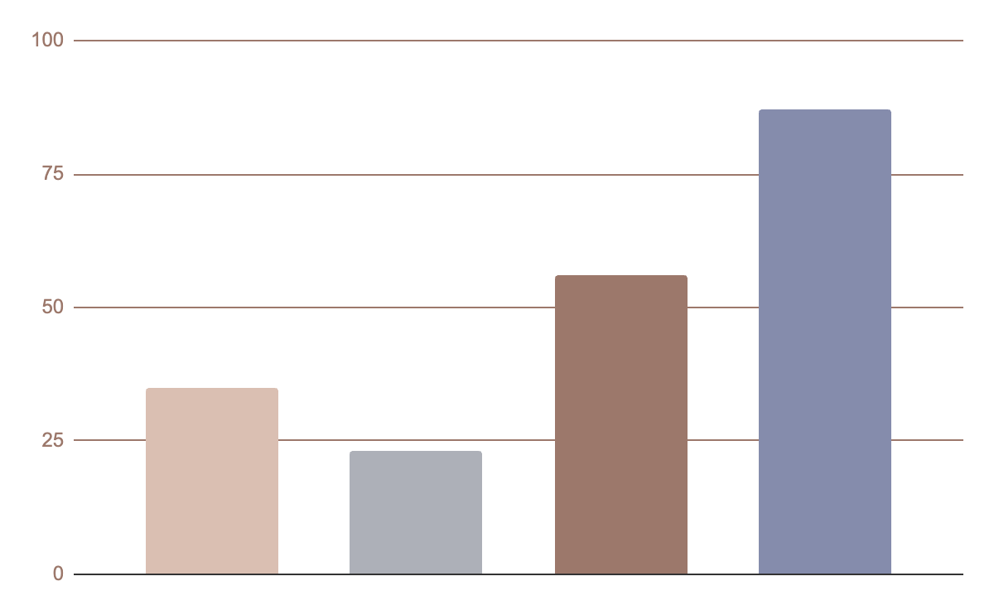
Vintage torn paper aesthetic agency
35%
Jupiter
Jupiter is the biggest planet of them all
23%
Mars
Despite being red, Mars is a very cold place
56%
Neptune
Neptune is the farthest planet from the Sun
87%
Mercury
Mercury is the closest planet to the Sun
Follow the link in the graph to modify its data and then paste the new one here. For more info, click here

Slide 12
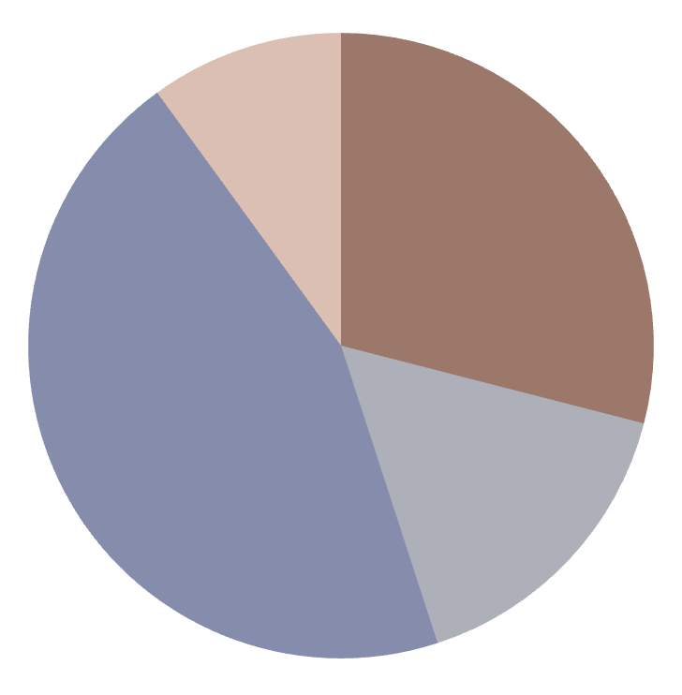
Vintage torn paper aesthetic agency
10
29%
Mercury
Jupiter
Mercury is the closest planet to the Sun
Jupiter is the biggest planet of them all
45%
16%
Neptune
Mars
Mercury is the closest planet to the Sun
Despite being red, Mars is a cold place
Follow the link in the graph to modify its data and then paste the new one here. For more info, click here

Slide 13
Vintage torn paper aesthetic agency
Neptune
Mars
Neptune is the farthest planet from the Sun
Despite being red, Mars is a very cold place
Mercury
What do
we offer?
Venus
Mercury is the closest planet to the Sun
Venus is the second planet from the Sun
Earth
Saturn
Earth is the third planet from the Sun
It’s composed of hydrogen and helium

Slide 14
Vintage torn paper aesthetic agency
79%
99%
88%
Neptune
Mercury
Jupiter
It’s the farthest planet from the Sun
Mercury is the closest planet to the Sun
Jupiter is the biggest planet of them all

Slide 15
Vintage torn paper aesthetic agency
Jenna Doe, 32
Helena Patterson,43
“Saturn is the second-largest planet in the Solar System. It has many rings”
“Venus has a beautiful name and is the second planet from the Sun”
What do they say about us?
John James, 24
Susan Bones, 50
“Despite being red, Mars is actually a cold place. It's full of iron oxide dust”
“Mercury is the closest planet to the Sun and the smallest in the Solar System”

Slide 16
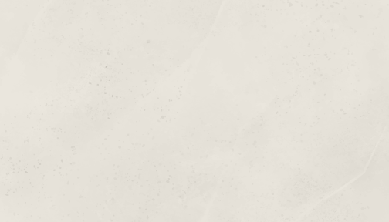
Vintage torn paper aesthetic agency
Social network
Despite being red, Mars is a cold place
Networking
Venus is the second planet from the Sun
Website
Saturn is a gas giant and has several rings
Email marketing
Earth is the third planet from the Sun

Slide 17
Vintage torn paper aesthetic agency
Copy
Photography
What do we offer?
Venus is the second planet from the Sun
Mercury is the closest planet to the Sun
Saturn is a gas giant and has several rings. It's composed mostly of hydrogen and helium. It was named after the Roman god of wealth and agriculture
Design
Programming
Jupiter is the biggest planet of them all
Mars is actually a very cold place

Slide 18
Vintage torn paper aesthetic agency
1999
2010
2015
2020
Mars
Venus
Saturn
Jupiter
Despite being red, Mars is a cold place
Venus is the second planet from the Sun
Saturn was named after a Roman god
Jupiter is the biggest planet of them all

Slide 19



Vintage torn paper aesthetic agency
Helena James
Sean Smith
James Patterson
You can replace the image on the screen with your own
You can replace the image on the screen with your own
You can replace the image on the screen with your own
Meet the team

Slide 20

Vintage torn paper aesthetic agency
Name | Gender
Anne Williams | Female
Age | Category
25-35 | Mars is very cold
Audience | Social network
Venus is very hot | Mercury is small
Our client’s profile

Slide 21
Vintage torn paper aesthetic agency
Susan James, 35
John Travis, 54
Erica James, 28
“Despite being red, Mars is actually a cold place. It's full of iron oxide dust”
“Mercury is the closest planet to the Sun and the smallest in the Solar System”
“Venus has a beautiful name and is the second planet from the Sun”

Slide 22
Vintage torn paper aesthetic agency
Case studies
Opportunity
Proffer
Implantation
Mercury is the closest planet to the Sun and the smallest one in the entire Solar System
Despite being red, Mars is actually a very cold place. This planet is full of iron oxide dust
Venus has a beautiful name and is the second planet from the Sun. It’s terribly hot

Slide 23
Vintage torn paper aesthetic agency
Our awards | 2015 | 2018 | 2021
Award | Venus | Saturn | Jupiter
Location | Venus is the second planet from the Sun | Saturn was named after a Roman god | Jupiter is the biggest planet of them all

Slide 24
Vintage torn paper aesthetic agency
Our growth
50%
25%
12%
25%
Venus
Mars
Mercury
Saturn
Venus has a beautiful name
Mars is full of iron oxide dust
Mercury is the smallest planet
Saturn is the ringed planet

Slide 25
Vintage torn paper aesthetic agency
Our plans
Basic | Pro | Premium
Mercury | Venus | Saturn
Mercury is the closest planet to the Sun | Venus is the second planet from the Sun | It’s composed of hydrogen and helium

Slide 26
Vintage torn paper aesthetic agency
Jan
Feb
March
April
May
Phase 1
January 1st - March 31th
Task 1
January 1st - February 22th
Task 2
February 23th - March 31th
Phase 2
April 1st - May 27th

Slide 27
Vintage torn paper aesthetic agency
Upcoming projects
Venus
Mars
Venus has a beautiful name
Mars is full of iron oxide dust
Mercury
Mercury is the smallest planet

Slide 28
Vintage torn paper aesthetic agency
Checklist project | Done | To do
Saturn is the second-largest planet in the Solar System | x
Neptune is the fourth-largest planet in the Solar System |  | x
Despite being red, Mars is actually a cold place | x
Venus has a beautiful name, but also high temperatures |  | x
Jupiter is the biggest planet in the Solar System | x

Slide 29
Vintage torn paper aesthetic agency
Neptune
Neptune is the farthest planet from the Sun
Venus
Jupiter
Review of past events
It’s the second planet from the Sun
Jupiter is the biggest planet of them all
Saturn
It’s composed of hydrogen and helium

Slide 30
Vintage torn paper aesthetic agency
Venus
4/5
It’s the second planet from the Sun
Conclusions
Earth
5/5
Earth is the third planet from the Sun
Despite being red, Mars is actually a cold place. It's full of iron oxide dust, which gives the planet its reddish cast

Slide 31
Vintage torn paper aesthetic agency
79%
99%
88%
75%
20%
50%
30%
Neptune
Mercury
Jupiter
Saturn
Neptune is very far away from Earth
Mercury is the closest planet to the Sun
Jupiter is the biggest planet of them all
Saturn is a gas giant and has several rings
Some porcentages

Slide 32

Vintage torn paper aesthetic agency
 | Marketing team profile
 | Job position | Clients | Hits accumulated
 | Marketing manager | Works with premium customers | 500k accumulated impressions
Sara James | Jupiter is the biggest planet of them all | Saturn is a gas giant and has several rings | Venus is the second planet from the Sun

Slide 33
Instructions for use
If you have a free account, in order to use this template, you must credit Slidesgo in your final presentation. Please refer to the next slide to read the instructions for premium users.
As a Free user, you are allowed to:
- Modify this template.
- Use it for both personal and commercial projects.
You are not allowed to:
- Sublicense, sell or rent any of Slidesgo Content (or a modified version of Slidesgo Content).
- Distribute Slidesgo Content unless it has been expressly authorized by Slidesgo.
- Include Slidesgo Content in an online or offline database or file.
- Offer Slidesgo templates (or modified versions of Slidesgo templates) for download.
- Acquire the copyright of Slidesgo Content.
For more information about editing slides, please read our FAQs or visit Slidesgo School:
https://slidesgo.com/faqs and https://slidesgo.com/slidesgo-school

Slide 34
Instructions for use (premium users)
As a Premium user, you can use this template without attributing Slidesgo.
You are allowed to:
Modify this template.
Use it for both personal and commercial purposes.
Share this template in an editable format with people who are not part of your team.
You are not allowed to:
Sublicense, sell or rent this Slidesgo Template (or a modified version of this Slidesgo Template).
Distribute this Slidesgo Template (or a modified version of this Slidesgo Template) or include it in a database or in any other product or service that offers downloadable images, icons or presentations that may be subject to distribution or resale.
Use any of the elements that are part of this Slidesgo Template in an isolated and separated way from this Template.
Register any of the elements that are part of this template as a trademark or logo, or register it as a work in an intellectual property registry or similar.
For more information about editing slides, please read our FAQs or visit Slidesgo School:
https://slidesgo.com/faqs and https://slidesgo.com/slidesgo-school

Slide 35
Infographics
You can add and edit some infographics to your presentation to present your data in a visual way.
Choose your favourite infographic and insert it in your presentation using Ctrl C + Ctrl V or Cmd C + Cmd V in Mac.
Select one of the parts and ungroup it by right-clicking and choosing “Ungroup”.
Change the color by clicking on the paint bucket.
Then resize the element by clicking and dragging one of the square-shaped points of its bounding box (the cursor should look like a double-headed arrow). Remember to hold Shift while dragging to keep the proportions.
Group the elements again by selecting them, right-clicking and choosing “Group”.
Repeat the steps above with the other parts and when you’re done editing, copy the end result and paste it into your presentation.
Remember to choose the “Keep source formatting” option so that it keeps the design. For more info, please visit Slidesgo School.

